Slide 1
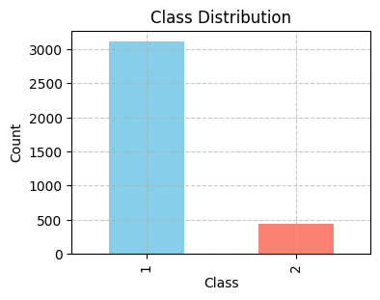
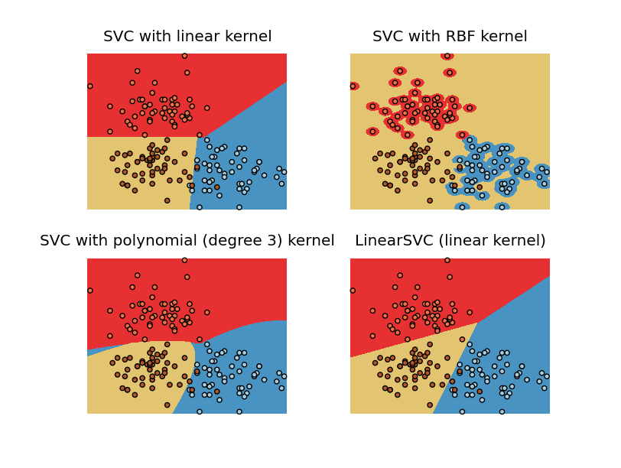
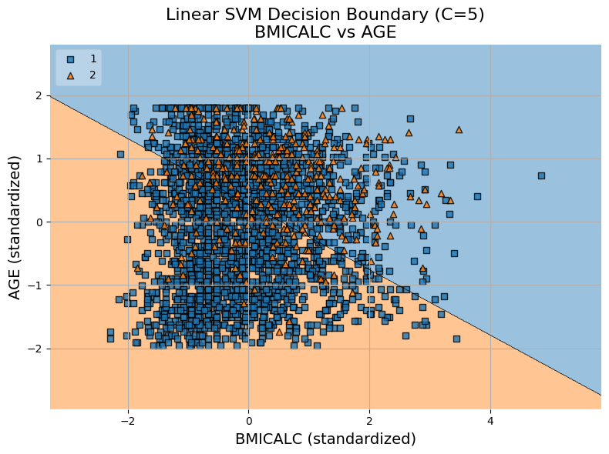
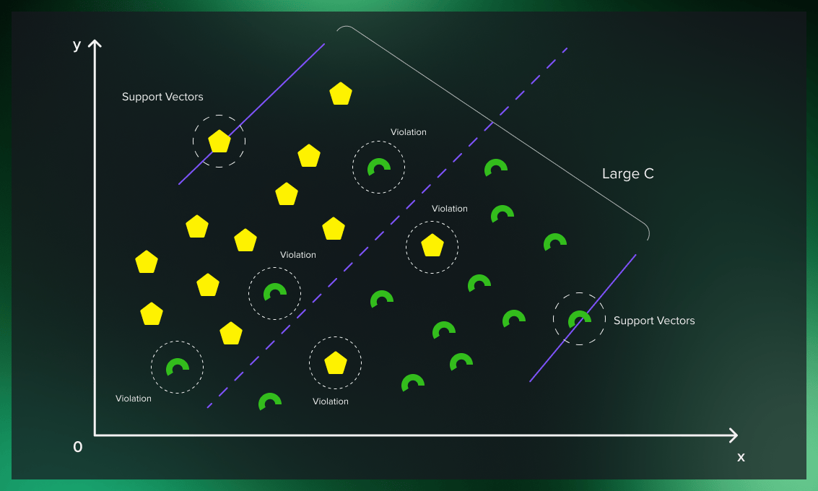
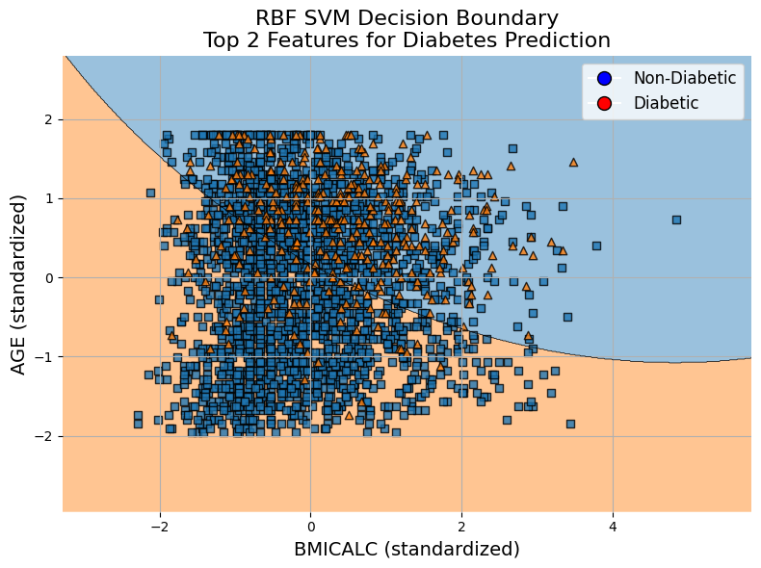
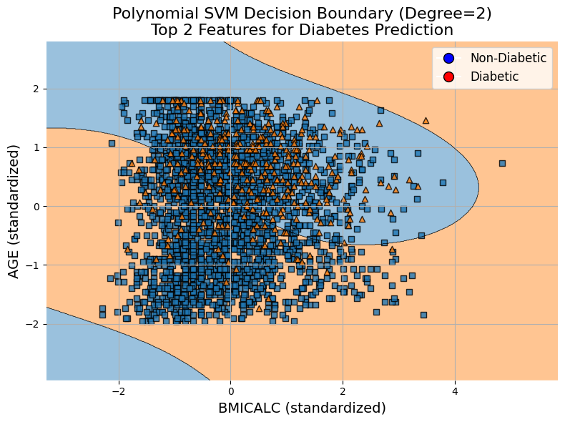
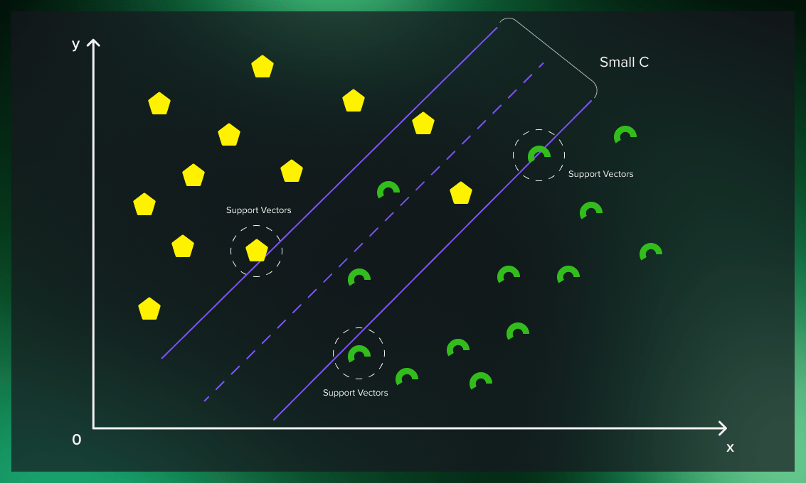
Predicting Diabetes Risk Using Support Vector Machines and Health Behavior Indicators
Fariha Shah
MS Data Science – Seattle University
Introduction
Discussion/Plots/Results
In this practical worksheet we have explored the use of support vector models using 3 model types (Linear, radial, polynomial kernels) for classification using IPUMS Health survey dataset. We have assigned the task is to explore how health behaviors impact health outcomes. The data was collected via the National Health Interview Survey through IPUMS Health Survey. This data set contains variables regarding respondent's demographics, 5 major health conditions such as (cancer, heart disease, diabetes, heart attack and stroke) and their lifestyle and behaviors like work hours, physical activity, sleep habits, and eating habits.
Trained Three different SVM model (Linear, Kernel, Polynomial ) with default hyperparameters
 | SVM (Linear Kernel) | SVM (RBF) Kernel | SVM (Polynomial) Kernel
Accuracy | 67% | 77% | 68%
Recall | (No: 65%) (Yes: 79%) | (No: 81%) (Yes: 51%) | (No: 70%) (Yes: 55%)
F1-Score | (No: 78%) (Yes: 34%) | (No: 86%) (Yes: 33%) | (No: 80%) (Yes: 28%)
Precision | (No: 98%) (Yes:22%) | (No: 93%) (Yes: 25%) | (No: 92%) (Yes: 19%)
Technical Background
Support Vector Machines (SVMs in short) are machine learning algorithms that are used for classification and regression purposes.
SVM algorithm is implemented using a kernel It uses a technique called the kernel trick. In simple words, a kernel is just a function that maps the data to a higher dimension where data is separable. In the context of SVMs, there are 4 popular kernels –Linear kernel, Polynomial kernel, Radial Basis Function (RBF) kernel (also called Gaussian kernel) and Sigmoid kernel. These are described below :
Linear: The linear kernel is computationally efficient and works well when the data is linearly separable. It is a good choice for a starting point.
Radial Basis Function (RBF) - Default: RBF kernel is versatile and often works well in practice. It is suitable for capturing complex relationships in the data.
Polynomial (Poly): The polynomial kernel is effective in capturing non-linear relationships. The degree of the polynomial can be adjusted to control the model complexity.
Used GridSearchCV to find the best hyperparameter for all three kernels with optimal values of (c, gamma, degree) .
 | SVM (Linear Kernel) | SVM (RBF) Kernel | SVM (Polynomial) Kernel
Accuracy | 68% | 89% | 66%
Recall | (No: 68%) (Yes: 70%) | (No: 100% ) (Yes : 0%) | (No: 66%) (Yes73%)
F1-Score | (No:79%) (Yes: 33%) | (No:94%) (Yes:0%) | (No : 78% ) (Yes:33%)
Precision | (No: 95%) (Yes: 22%) | (No: 89%)(Yes:0%) | (No:95%) (Yes: 21%)
Class Imbalance:
There is severe class imbalance issue has been seen in the dataset (around 87% of the data response belongs “No” category where as only 12% of the data has “Yes”) .
The linear SVM decision boundary kernel separates diabetic and non-diabetic individuals based on standardized BMI and age which suggests that individuals with higher BMI and younger age are more likely to be classified as diabetic. And there is significant class overlap, indicating that BMI and age alone may not provide strong separation for diabetes prediction.
The C hyperparameter in a Support Vector Machine controls the trade-off between achieving a wide margin and correctly classifying training points.
A low C value allows the model to create a broader margin, even if it means allowing more misclassifications. This promotes generalization but may sacrifice some accuracy on the training data.
RBF SVM decision boundary plot captures more complex, nonlinear patterns between BMI, age, and diabetes status. The curved boundary adapts to clusters better than the linear model, but class overlap remains significant while BMI and age carry some predictive power, they may not be sufficient alone to clearly separate diabetic from non-diabetic individuals.
A high C value places a strong penalty on misclassified points, so the model focuses on minimizing classification errors. This often results in a tighter margin that fits the training data more closely, which can increase the risk of overfitting.
This Polynomial SVM decision boundary (degree=2) demonstrates a more flexible, curved separation between diabetic and non-diabetic groups using BMI and age. The wavy boundary indicates interactions between the two variables, but it still struggles with overlapping regions. This suggests that while a polynomial kernel captures more complexity than a linear one, additional features may be needed to improve classification.
Methodology
Conclusion
We analyzed survey data from the National Health Interview Survey to predict diabetes using support vector machines. After cleaning the dataset by removing unknown and top-coded values, and subset the data on the basis of region (South) only responses from greater than 18 age group and only responses from males. We selected key predictors related to age, BMI, weight, diet, and lifestyle. We handled class imbalance using class_weight='balanced' and trained Linear, RBF, and Polynomial SVM models. Hyperparameters were tuned using GridSearchCV. Model performance was evaluated using accuracy, classification report. Finally, decision boundaries and correlation heatmaps were used to interpret model behavior and feature relationships.
This study demonstrated the application of Support Vector Machines (SVMs) to predict diabetes using health behavior and demographic indicators from the National Health Interview Survey. Among the three kernels tested (Linear, RBF, and Polynomial), the RBF and Polynomial models captured more complex nonlinear patterns than the Linear model, though all showed challenges due to class imbalance and overlapping feature space. Hyperparameter tuning via GridSearchCV improved model performance, and decision boundary visualizations highlighted the limitations of using only BMI and age as predictors. Overall, while SVMs offer valuable insights into health outcome prediction, incorporating a broader set of features may enhance model accuracy and discrimination power.
References
https://www.kaggle.com/code/prashant111/svm-classifier-tutorial/notebook#2.-Support-Vector-Machines-intuition-
https://medium.com/@abhishekjainindore24/svm-kernels-and-its-type-dfc3d5f2dcd8
https://scikit-learn.org/stable/modules/generated/sklearn.model_selection.GridSearchCV.html
https://serokell.io/blog/support-vector-machine-algorithm

